Slide 1
Data Structures CS-2001 Week#2
Lecture 4, 5 and 6

Slide 2
Introduction
Why recursion?
Is some function calling itself?
Or function A calling another function B that in turn calls function A.

Slide 3
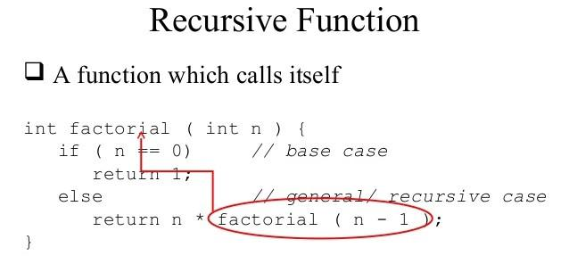
Major Requirements for Recursion
A function that call itself before the completion is called recursive function.
A Base Case
Terminate all recursive calls
Clearly identifiable
A Recurrence
Progression on input
Progression to base case

Slide 4
Working of recursion
Stack frame – our activation record
keeps the information about local variables, formal parameters, return address and all information passed to the caller function.

Slide 5
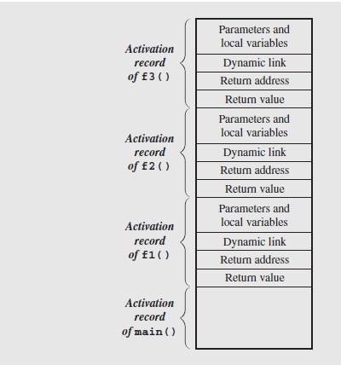
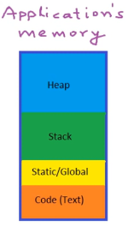
Stack Frame View
Contents of the run-time stack when main() calls function f1(), f1()
calls f2(), and
f2() calls f3().
Notes:
Because the stack may contain more than just frames (e.g., function return values or registers saved across calls), it is common to save the caller’s frame pointer as part of the callee’s control information. Each frame points to its caller’s frame on the stack. This pointer is called a dynamic link because it links a frame to its dynamic (runtime) predecessor.

Slide 6

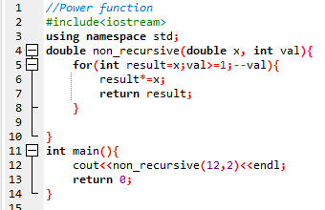
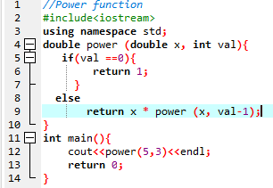

Recursive Function
A power function is defined in term of recursive definition and non recursive.

Slide 7
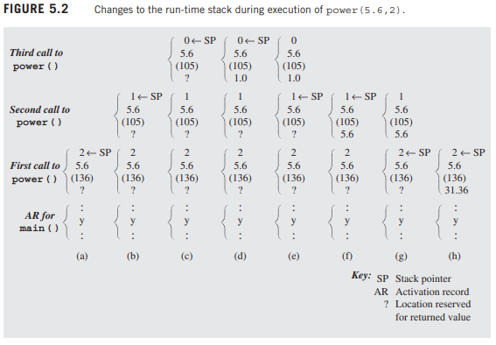
Stack frame in-depth view

Slide 8
Classification of Recursion
Tail vs. Non-Tail
Direct vs. Indirect
Simple vs. Excessive
Nested Recursion

Slide 9

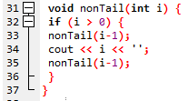
Tail Recursion
Tail Recursion is characterized by the use of only one recursive call at the very end of a function implementation.
This means when a recursive call is invoked there is no work left for the previous call.
Moreover, there is no pending recursive calls, either direct or indirect.

Slide 10


Tail vs Non Tail Recursion

Slide 11
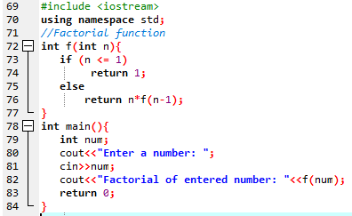
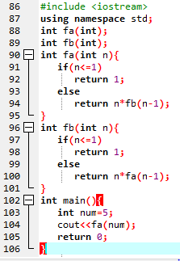
Direct Recursion vs Indirect Recursion
Direct recursion: When function calls itself, it is called direct recursion.
Indirect recursion: When function calls another function and that function calls the calling function, then this is called indirect recursion. For example: function A calls function B and Function B calls function A.

Slide 12
Nested Recursion
When a recursive function call is embedded into a recursive function, it is called “Nested Recursion”
Example of nested recursion is Ackerman function:
A(m,n) = n + 1 if m == 0
A(m,n) = A(m-1, 1) if m > 0 && n == 0
A(m,n) = A(m-1, A(m, n-1)) if m > 0 && n > 0
It is interesting for computational reasons due to the depth of recursion and due to the nested recursion.
For example, A(4, 2) is an integer of 19,729 decimal digits

Slide 13

Excessive Recursion
Some recursive methods repeats the computations for some parameters, which results in long computation time even for simple cases.
This can be implemented in c++ as follows:

Slide 14
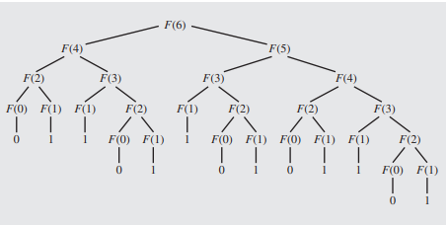
Excessive Recursion
To show how much this formula is inefficient, let us try to see how Fib(6) is evaluated.

Slide 15
Excessive Recursion: Example
For calculating fib(6), the method is called 25 times.
The same calculation are repeated again and again because the system forgets what have been already calculated.
The method is called 2*fib(n+1)-1 times to compute fib(n)
3,000,000 calls are needed to calculate the 31st element.

Slide 16
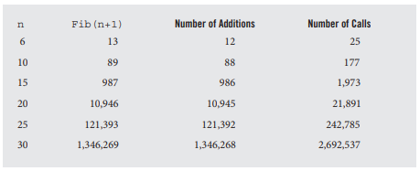
Comparison:
Number of addition operations and number of recursive calls to calculate Fibonacci numbers.

Slide 17
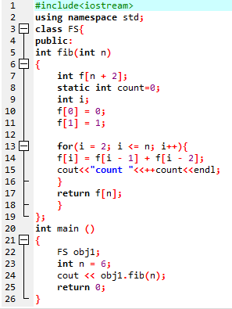
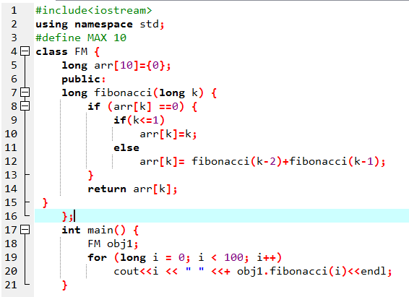
Memoizable Fibonacci recursive:

Slide 18
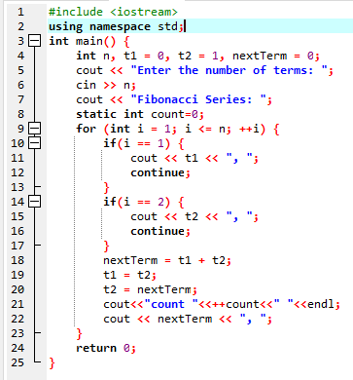
Iterative Method:

Slide 19
Conclusion
Recursion is a programming tool. Like any other topic in data structures, it should be used with good judgment.
Recursive solutions are simplified one for understanding, short and precise code, readability and maintainability are increases.
Sometimes, slow and hard on resources. Specifically available on only compilers that support recursion.
Sometimes recursion is faster than iterative approach. Running a simple routine implemented recursively and iteratively and comparing the two run times can help to decide if recursion is advisable.

Slide 20
Exercise:
Write a program in CPP to print first 50 natural numbers using recursion.
Write a program in CPP to calculate the sum of numbers from 1 to n using recursion.
Write a program in CPP to print Fibonacci Series using recursion.
Write a program in CPP to count the digits of a given number using recursion.
Write a program in CPP to find the sum of digits of a number using recursion.
Write a program in CPP to get the largest element of an array using recursion.
Write a program in CPP to check a number is a prime number or not using recursion.
Write a program in CPP to Check whether a given String is Palindrome or not. Example: civic

Slide 21
Lecture # 05

Slide 22
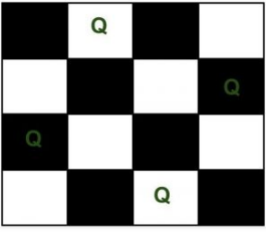
N-Queen Problem
We have N queens and N x N chess board. The objective of this problem is such that we need to place all N queens on N x N chess board in such a manner that no two queens in under attack to each other.
Legal move attacking means no 2 queens in same row, col, and diagonal
Two queens will be under attack if one of the following conditions is true:-
firstly, if they are in the same row.
secondly, if they are in the same column.
finally, if they are in the same diagonal.

Slide 23
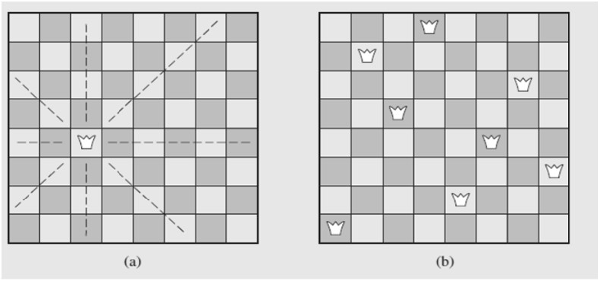
N-Queen Problem
Idea of the size of the problem:
There are 4,426,165,368 ways to arrange 8 queens on a chessboard of 64 squares.
No queen can reside in a row or a column that contains another queen
only 40,320 (8!) arrangements of queens to be checked for attacks along diagonals

Slide 24
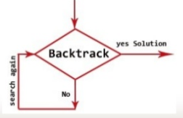
Back Tracking
Backtracking is an algorithmic technique for solving problems recursively by trying to build a solution incrementally, one piece at a time, removing those solutions that fail to satisfy the constraints of the problem at any point of time.

Slide 25
Backtracking Algorithm
The idea is to place queens one by one in different columns, starting from the leftmost column. When we place a queen in a column, we check for clashes with already placed queens.
In the current column, if we find a row for which there is no clash, we mark this row and column as part of the solution. If we do not find such a row due to clashes then we backtrack and return false.

Slide 26
Backtracking Algorithm
Start in the leftmost column
If all queens are placed
return true
Try all rows in the current column. Do following for every tried row.
If the queen can be placed safely in this row then mark this [row, column] as part of the solution and recursively check if placing queen here leads to a solution.
If placing the queen in [row, column] leads to a solution then return true.
If placing queen doesn't lead to a solution then unmark this [row, column] (Backtrack) and go to step (a) to try other rows.
If all rows have been tried and nothing worked, return false to trigger backtracking.

Slide 27
C++ Code:
Find attached file.

